Slide 1
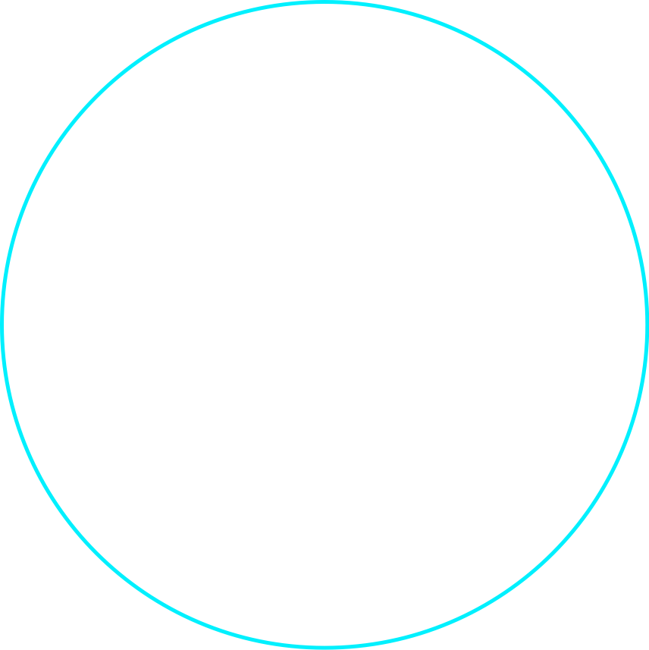


Slide 2


React Native Perf tuning – tips & trick
Mr. NGUYEN ANH TUAN
Mobile App Team Lead
Agiletech
Notes:
Hello everyone. My name is XYZ and I’m a ABC. I’m excited to introduce you to React and React Native that you can use to build web apps and native apps. During this talk you’ll get started on how to use them.

Slide 3





Facebook Ads Manager
React Native
Relay
GraphQL
Notes:
Facebook Ads Manager was the first app built using React Native plus a few other notable Facebook open source projects - Relay and GraphQL that help work with data.
The engineers working on the iOS app were not iOS developers. They were Ads engineers who knew JavaScript. First the team built the iOS version. Then the same engineers turned around and built the Android app.
Let’s go through a few key React Native features they used to build this app.

Slide 4
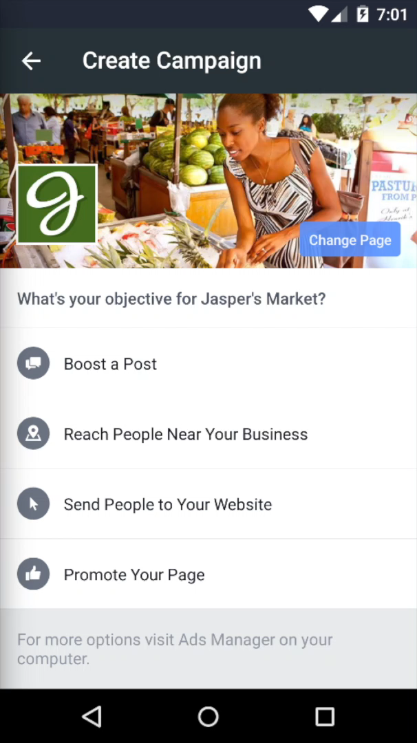

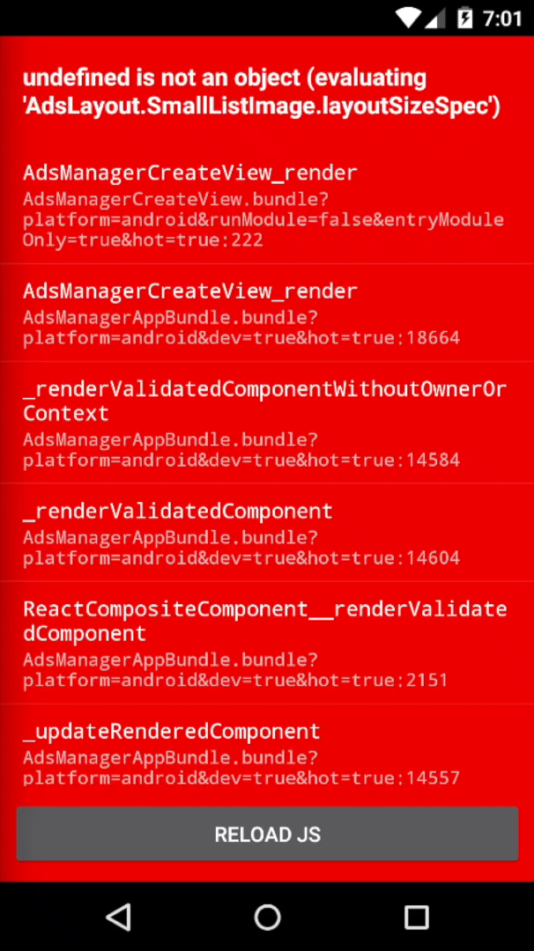

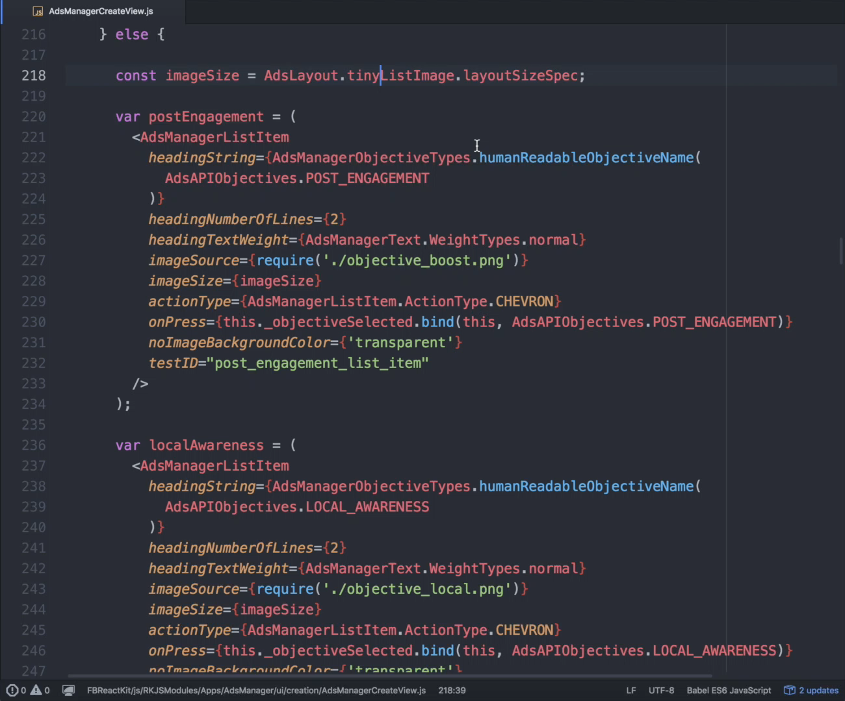
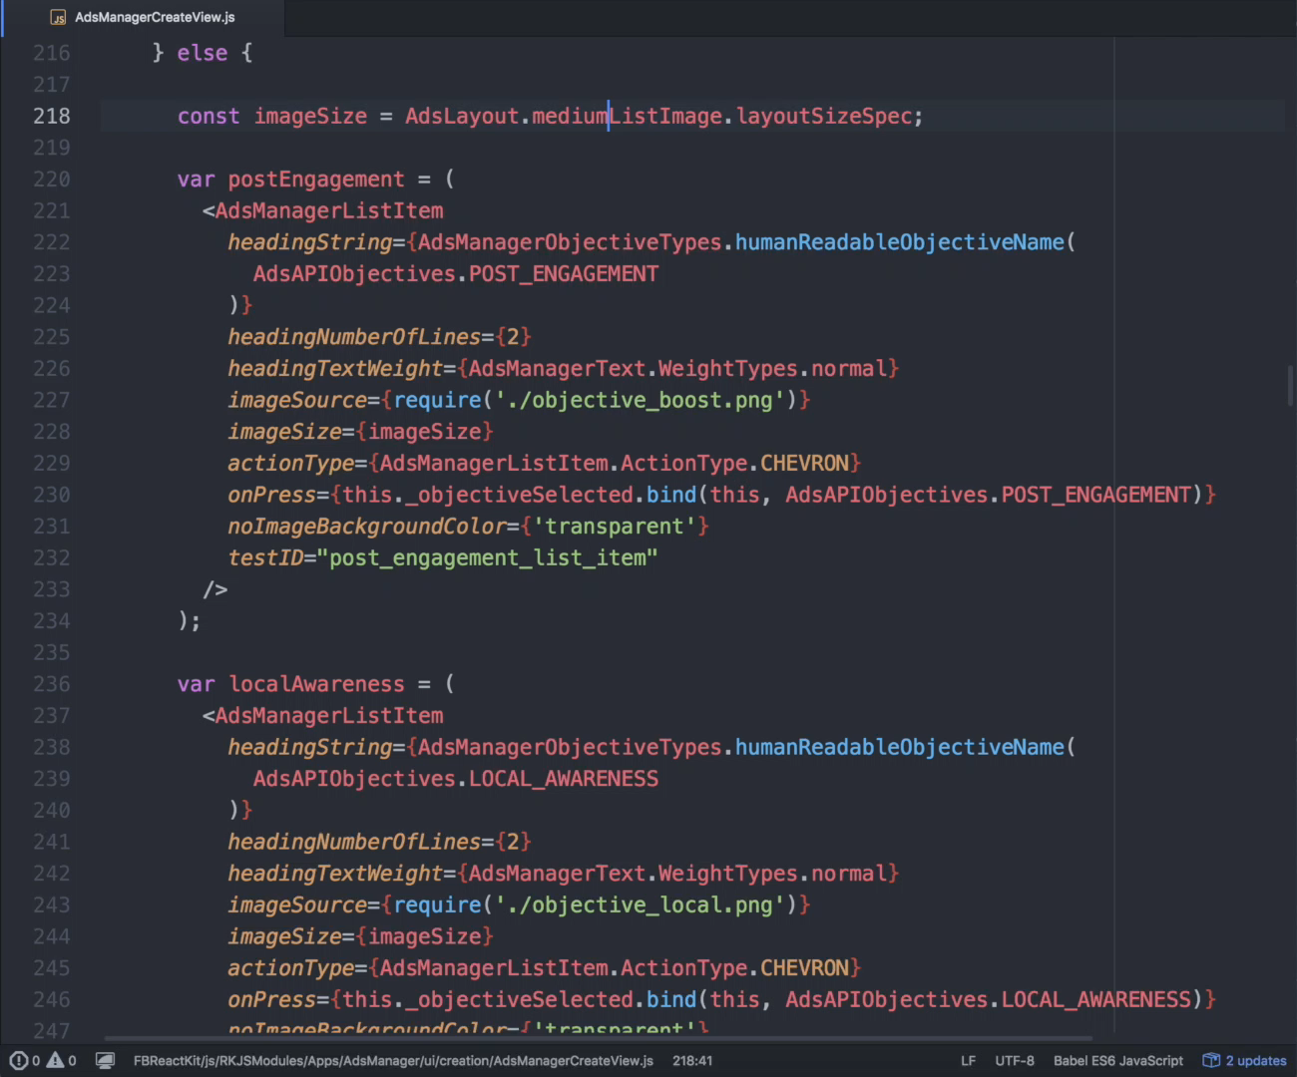
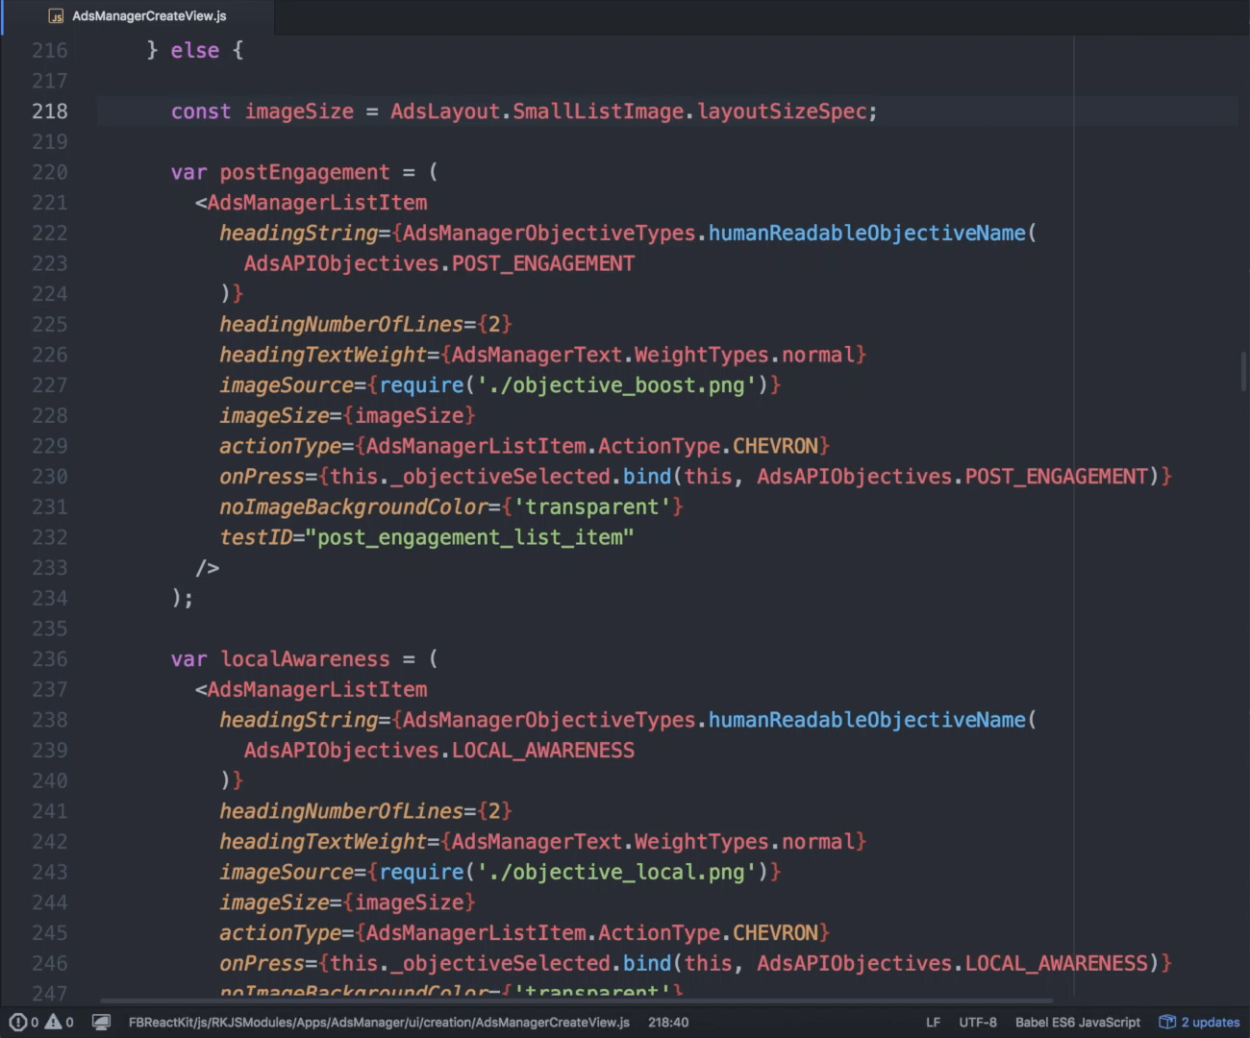
Hot Reload
Redbox
Inspect-element
On both platforms
Notes:
Here we have a screen from the ad creation flow within the FB Ads Manager
If we want to make the icons bigger
In pure native - it takes a lot of time for small changes
[CLICK] In ReactNative, hot reload - no compilation
[CLICK] Making mistake - redbox
[CLICK] Fix the typo
[CLICK] Last step: verify styling - using inspect element
[CLICK] It's available on both platforms

Slide 5

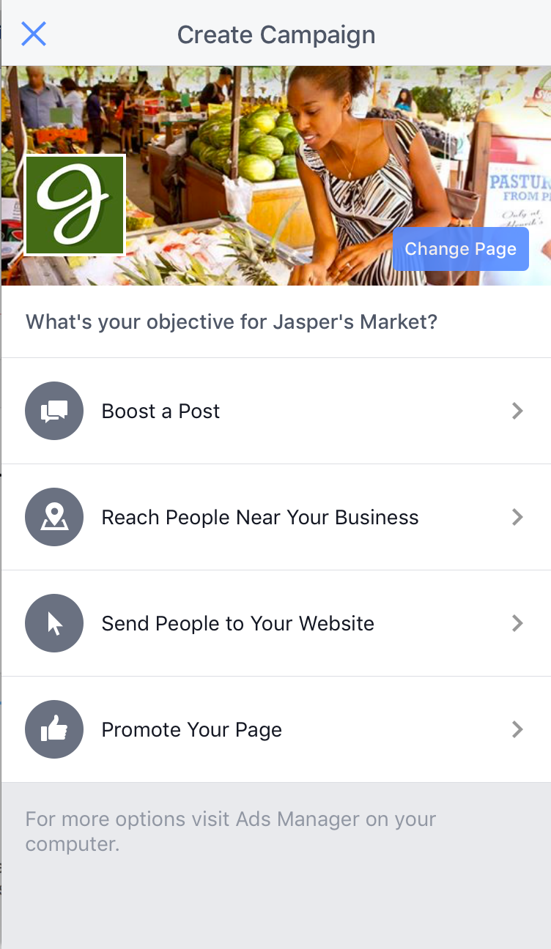


Building cross-platform UI components
Notes:
Generic ListItem component used throughout app
Same basic functionality - content, image, does something when you tap
We want slightly different behavior for each platform:
iOS: arrow/chevron to indicate it’s a tappable element
[CLICK] Android: show ripple when tapped, common pattern on Android
[CLICK] Look at code for when we only supported iOS

Slide 6
class ListItem extends React.Component {
render() {
return (
<TouchableHighlight>
<View>
{this.props.header}
</View>
<View>
{this.props.detail}
<Chevron />
</View>
</TouchableHighlight>
);
}
}
Notes:
Simplified example to illustrate a point
TouchableHighlight for underlay
Display content
Chevron
If we want this component to support different behavior for Android - inline with Platform module
[CLICK] First we can get rid of the chevron on Android

Slide 7
class ListItem extends React.Component {
render() {
return (
<TouchableHighlight>
const content = (
<View>
{this.props.header}
</View>
<View>
{this.props.detail}
{Platform.OS === 'ios' ? <Chevron /> : null}
</View>
);
</TouchableHighlight>
);
}
}
{content}
Notes:
Get rid of chevron on Android - easy enough
To show ripple effect, we’ll need to use a different touchable component, TouchableNativeFeedback
[CLICK] To use this we’ll need to refactor a little bit.

Slide 8
class ListItem extends React.Component {
render() {
const content = (
<View>
{this.props.header}
</View>
<View>
{this.props.detail}
{Platform.OS === 'ios' ? <Chevron /> : null}
</View>
);
if (Platform.OS === 'android') {
return (
<TouchableNativeFeedback>
{content}
</TouchableNativeFeedback>
);
}
return (
<TouchableHighlight>
{content}
</TouchableHighlight>
);
}
}
Notes:
Now 1 component with different behavior for platforms.
Works fine - only problem is to reuse this logic, do it all over again
In our app, we abstract away platform-specific logic into its own component.
Feature of RN - specify certain file extensions ignored on certain platform.
e.g. ‘ios.js’ not included in Android JS bundle, & vice versa
2 implementations of the same component
[CLICK] In this example…

Slide 9
class ListItem extends React.Component {
render() {
// Touchable.ios.js
class Touchable extends React.Component {
render() {
return (
<TouchableHighlight>
{this.props.children}
<Chevron />
</TouchableHighlight>
);
}
}
return (
const content = (
<View>
{this.props.header}
</View>
<View>
{this.props.detail}
{Platform.OS === 'ios' ? <Chevron /> : null}
</View>
);
if (Platform.OS === 'android') {
return (
<TouchableNativeFeedback>
{content}
</TouchableNativeFeedback>
);
}
return (
<TouchableHighlight>
{content}
</TouchableHighlight>
<Touchable>
<View>
{this.props.header}
</View>
<View>
{this.props.detail}
</View>
</Touchable>
// Touchable.android.js
class Touchable extends React.Component {
render() {
return (
<TouchableNativeFeedback>
{this.props.children}
</TouchableNativeFeedback>
);
}
}
);
}
}
Notes:
In this example, create a Touchable component with two implementations
iOS -> TouchableHighlight, Chevron
Android -> TouchableNativeFeedback, no chevron
In ListItem use this component, automatically get correct behavior
This is powerful, and makes it easy to reuse this logic throughout our app.
When we first built Android, built a bunch of these low-level components with two implementations

Slide 10
Simplified UI Layout
declarative layout
Notes:
Let's talk about design in React Native. Since we define our UI declaratively, we can simplify layout a lot!
[CLICK] Instead of manually calculating layout or debugging cascading style rules, we use inline styles with a flexbox API in React Native.

Slide 11
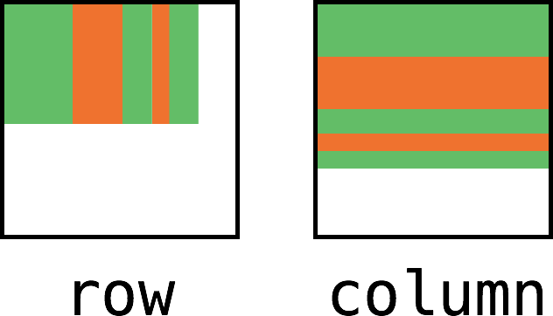
flexDirection
row
column
Notes:
Flexbox is a CSS-standard for layout that allows you you to position your content in a row-based or column-based container.

Slide 12
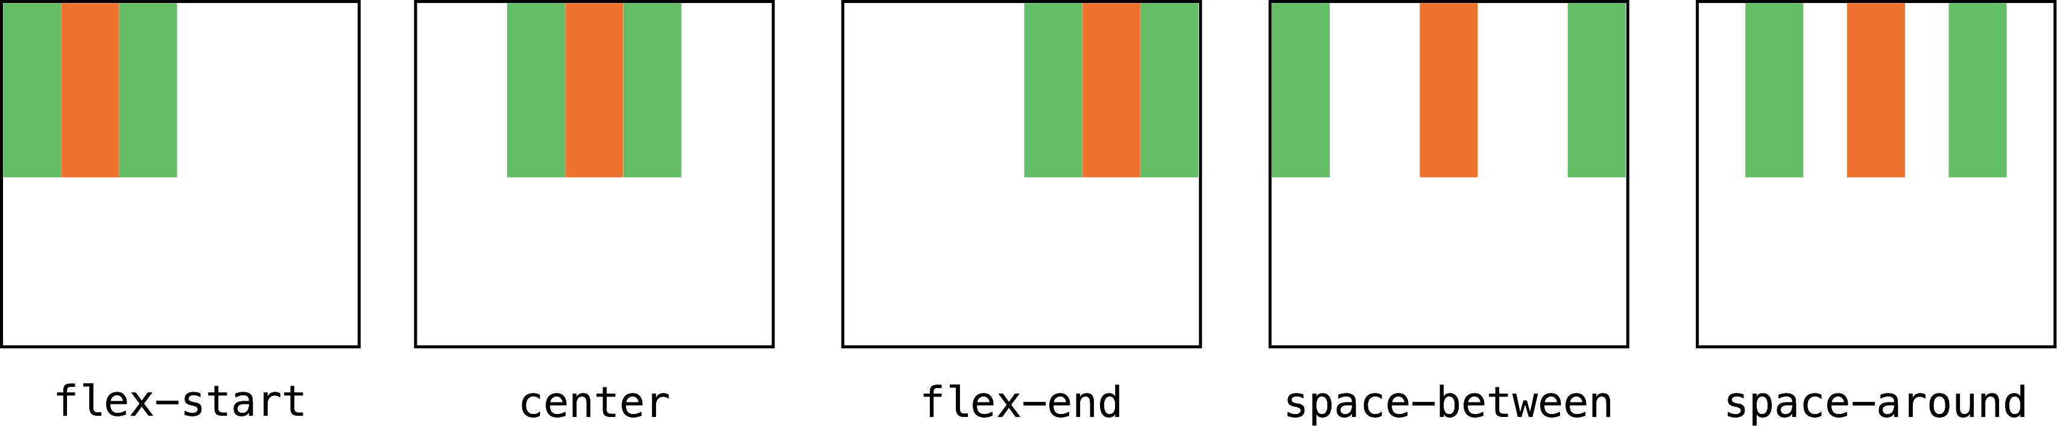
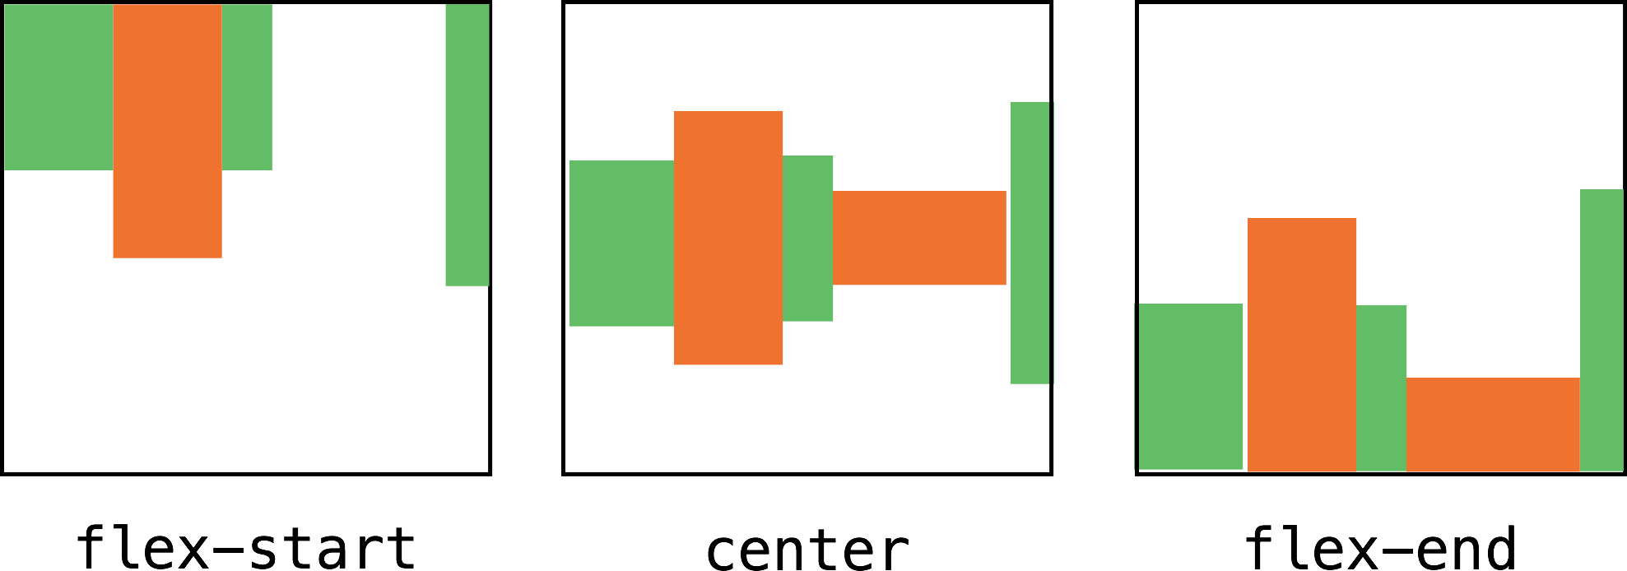
justifyContent
flex-start
center
flex-end
space-between
space-around
alignItems
flex-start
center
flex-end
Notes:
You can align items in a specific way along the main axis (justifyContent), but then also define how they should be laid in the cross axis (alignItems), allowing you to very quickly build complex layouts
…and there are plenty more layout options, or you could always position things explicitly if you prefer.

Slide 13

Inline Styles
github.com/facebook/yoga
<View style={styles.row}>
…
</View>
——————————
styles = {
row: {
flexDirection: 'row',
alignItems: 'center',
padding: 5,
backgroundColor: 'white',
},
};
Notes:
This is what the inline styles look like in code. They are simply JavaScript objects that get translated by React Native into layout information in the resultant native UI.

Slide 14
Learn once, Write anywhere
NOT
Write once, Run anywhere
Notes:
A lot of cross-platform frameworks chase this mythical motto that is “write once, run anywhere”. We’ve found that this just doesn’t work. In order to feel good on multiple platforms, sometimes you need custom code.
[CLICK] Instead, we’ve decided to go with the goal “Learn Once, Write Anywhere”.
React Native uses the the exact same API as React on Web, and even uses the exact same code under the hood. This means people can learn React and use those skills to develop on any platform.
This is a huge win for us at Facebook, since learning a new platform takes a lot of time.

Slide 15
Two Ways to Get Started
1. Set up your Android or iOS developer environment
2. Install the CLI
$ npm install -g react-native-cli
3. Create your project
$ react-native init MyApp
$ cd MyApp; react-native run-android
4. Start app!
Notes:
So how do you get up and running with React Native? Well there are two ways, each involving running a script to set up a “starter” app that you can work with.
You can install the React Native CLI and use to create your starter app.

Slide 16
OR
Notes:
Alternatively…

Slide 17
Get Started even Faster!
1. Use Create React Native App!
2. Install the CLI
$ npm install -g create-react-native-app
3. Create your project
$ create-react-native-app MyApp
$ cd MyApp; npm start
4. Start app!
Notes:
You can use the command line interface provided by the Create React Native App project. Once you’ve installed its CLI you can create your starter app.
The method you use to create the starter app depends on whether you’re going to be integrating with native iOS or Android components within your app. You can find more details on the React Native website.

Slide 18


Your
App!!
Notes:
Now that you have your starter app, you can use the boilerplate code provided to start customizing and building your app.

Slide 19
Component Life Cycle
Mounting
Updating
Unmounting
Notes:
Alternatively…

Slide 20
Mounting
constructor(props)
componentWillMount()
render()
componentDidMount()
Notes:
Alternatively…

Slide 21
Updating
componentWillReceiveProps(nextProps)
shouldComponentUpdate(nextProps, nextState)
componentWillUpdate(nextProps, nextState)
render()
componentDidUpdate(prevProps, prevState)

Slide 22
Unmounting
componentWillUnmount()

Slide 23
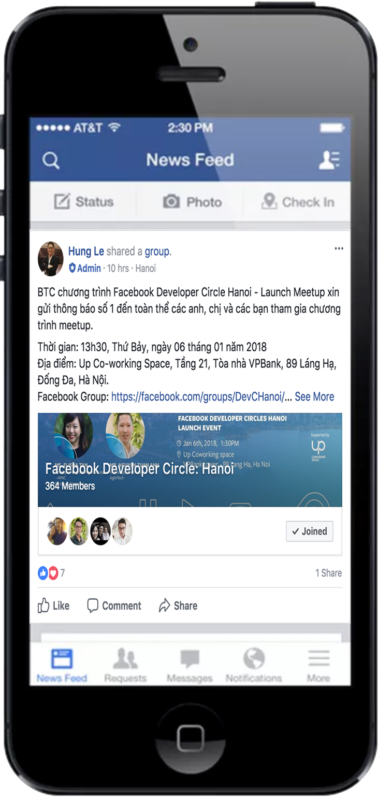


Tips & trick

Slide 24

Practice
Code Example
More information
https://github.com/anhtuank7c/facebookdevcirclehanoi
Notes:
To find out more and explore our open source offerings, check out this link.

Slide 25

Thank You
Notes:
You should now more insight into why we built React and React Native. There’s a lot more to learn by visiting the project websites and getting involved with the community. The hope is that we’ll see you build some great projects with this tech and other projects we’ve shared.
Thank You!!

